Slide 1
Gradient Origin Networks
Sai Surya Vidul Chinthamaneni
Anvith Reddy Nemali

Slide 2
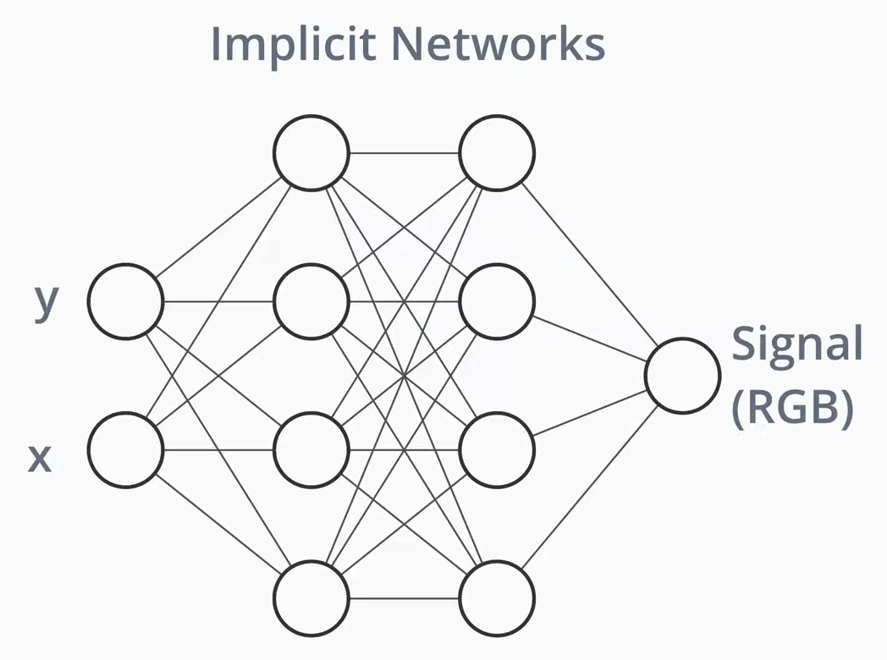

PROBLEM STATEMENT AND MOTIVATION
Traditional generative models like Variational Autoencoders (VAEs) and Generative Adversarial Networks (GANs) rely architectures with separate encoding networks and multiple iterative processes. This complexity increases computational costs and model size Gradient Origin Networks (GON) A new type of implicit generative model. They capture datasets without an explicit encoder and can generate samples in a single step.
Streamlined Architecture: Eliminate the need for separate encoders by using gradients to perform encoding, reducing overall model complexity.
Efficiency: Achieve faster convergence and lower reconstruction errors with fewer parameters
Anomaly Detection
Anomaly detection identifies data points that significantly deviate from expected patterns.

Slide 3
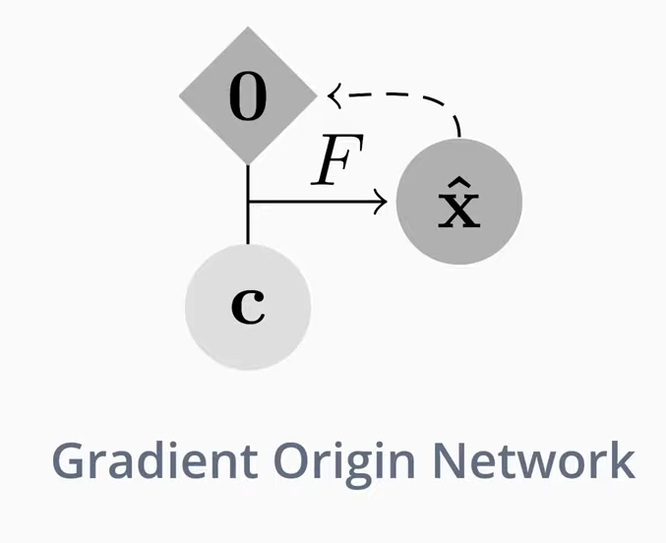
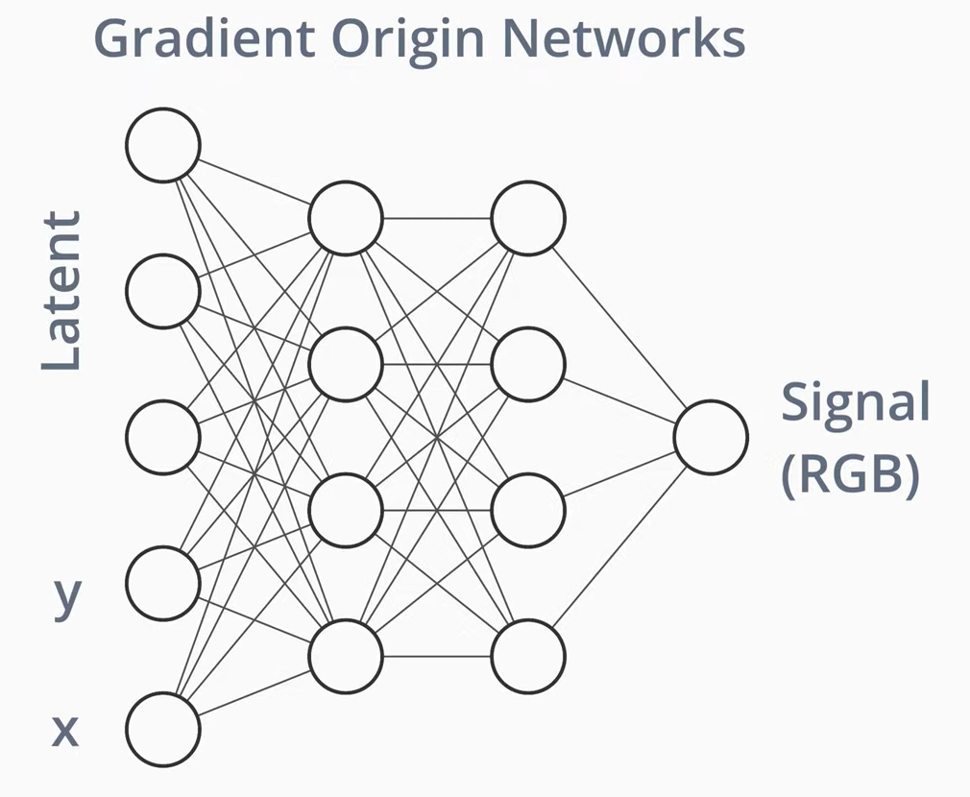
FRAMEWORK OVERVIEW
Gradient Origin Network:
Components:
Latent Vector (z0): Initialized at zero.
Coordinates ( c ): Input features (e.g., pixel positions).
Network (F): Single network for both encoding and decoding.
Output (x^) : Reconstructed data (e.g., image)
Process:
Latent Initialization: Start with z0 at zero.
Gradient Encoding: Compute the gradient to encode data.
Reconstruction: Network F combines gradient and coordinates c to generate the output x^.

Slide 4
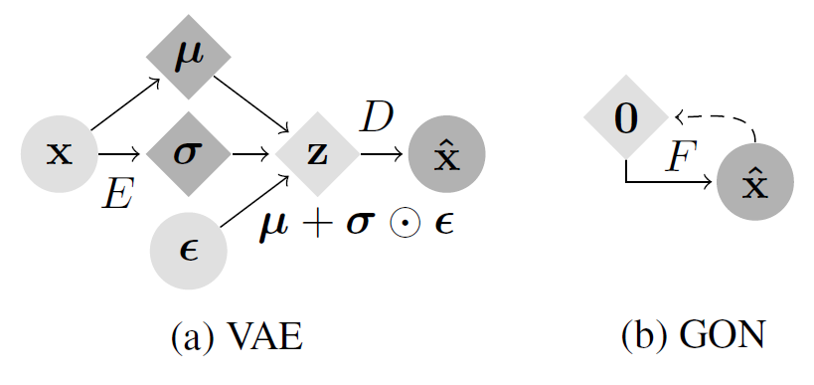
METHODOLOGY

Slide 5
METHODOLOGY
ANOMALY DETECTION
The anomalies in the dataset are detected based on a dynamic threshold implemented as follows
threshold=mean_loss+2⋅std_loss
This threshold is compared against the reconstruction losses obtained.
Reconstructions losses > threshold - Anomalies
Reconstructions losses < threshold - Normal Images
During the evaluation phase, the reconstruction error for each image is computed as the mean squared error between the generated image and the original image.

Slide 6
EXPERIMENTS AND RESULTS
EXPERIMENTS
Gradient Origin Network
Gradient Origin Network for Anomaly Detection
AutoEncoder for Anomaly Detection
DATASETS
Corrupted MNIST
MVTec AD
SPLIT | IMAGES
Train (No Defective) | 60000
Test (2K each from 14 types of corruption and original MNIST test of 2K) | 30000
SPLIT | IMAGES
Train (No Defective) | 3629
Test (Good - 467 and Defective - 1258) | 1725

Slide 7
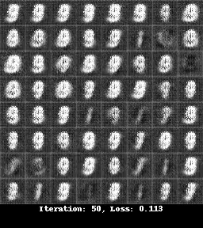
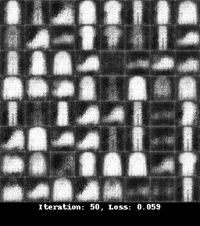
RESULTS - GON

Slide 8
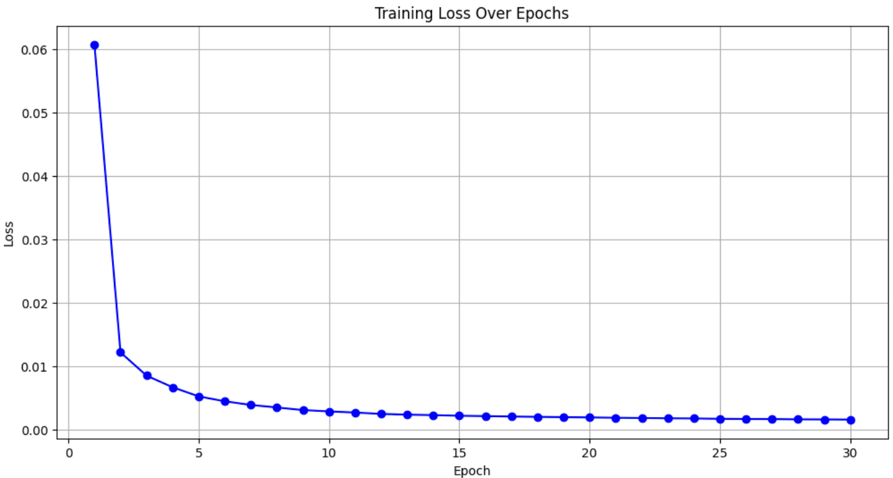
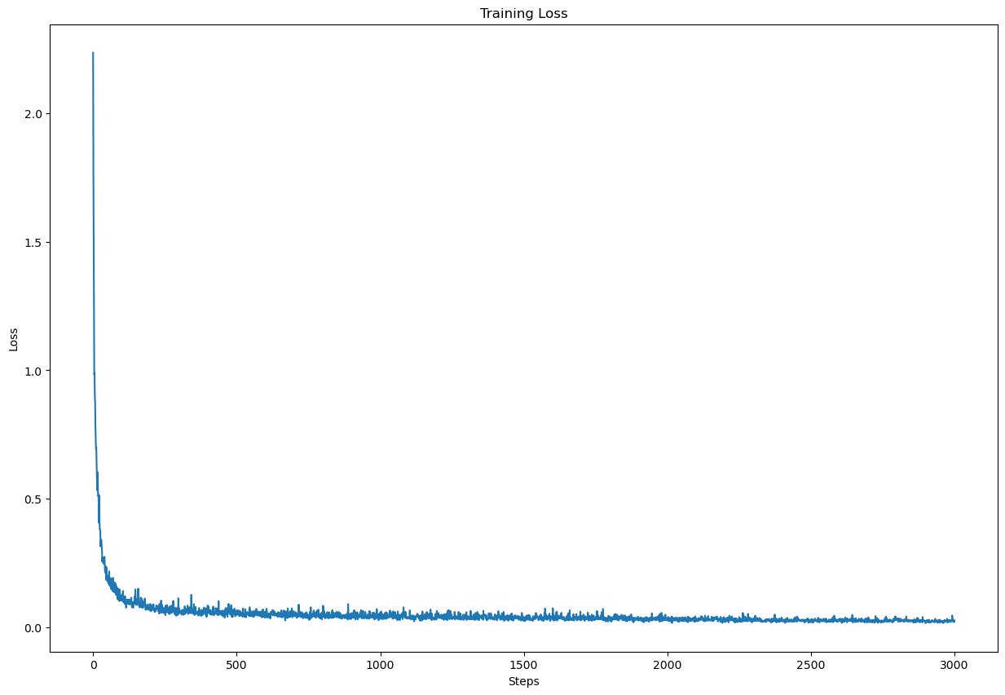
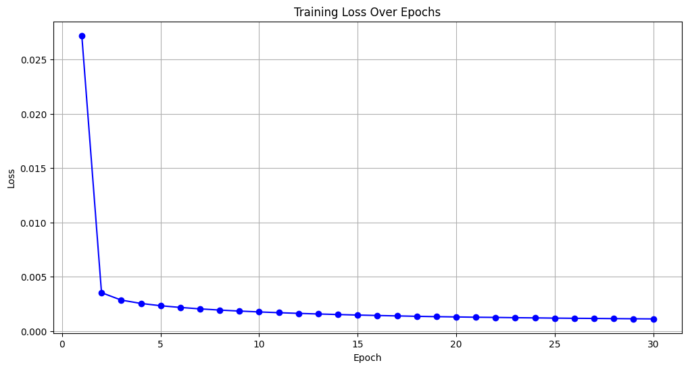
RESULTS - LOSS
GON - MNIST
GON - MVTec AD
CAE - MNIST

Slide 9
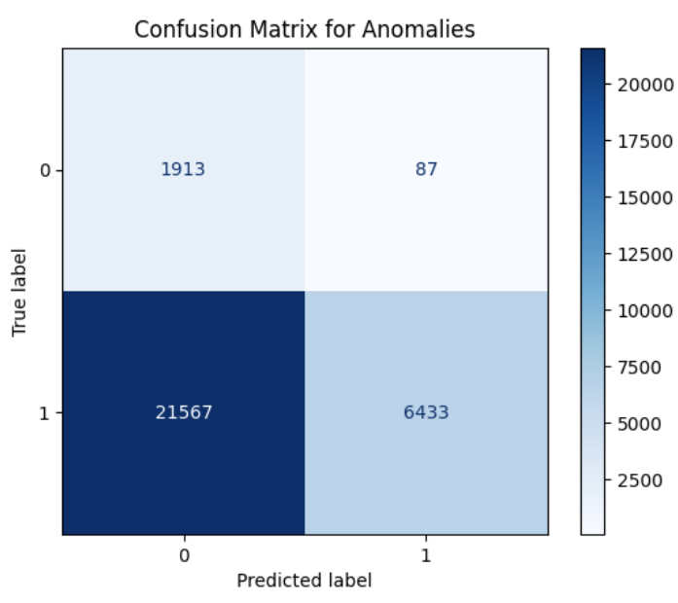
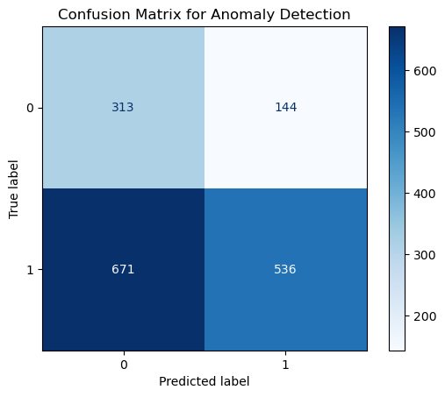
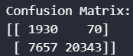
RESULTS - CONFUSION MATRIX
GON - MNIST
GON - MVTec AD
CAE - MNIST

Slide 10
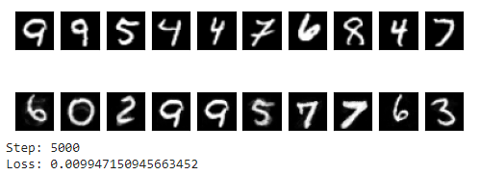
ADDITIONAL WORK
Optimal Transport Decoder for Tiny Datasets Using GeomLoss and demonstrate a Sinkhorn divergence-based generative model. Effective for small datasets; enhances generative model performance.

Slide 11
THANK YOU

